Slide 1


The largest international scientific organization of experts dedicated to reducing the worldwide burden of tropical infectious diseases and improving global health.

Slide 2

What Members Value Most
“Access to research on the latest diseases/treatments”
“Standing within your global community”
“Learning about clinical cases and field work”
“Finding collaborators”

Slide 3
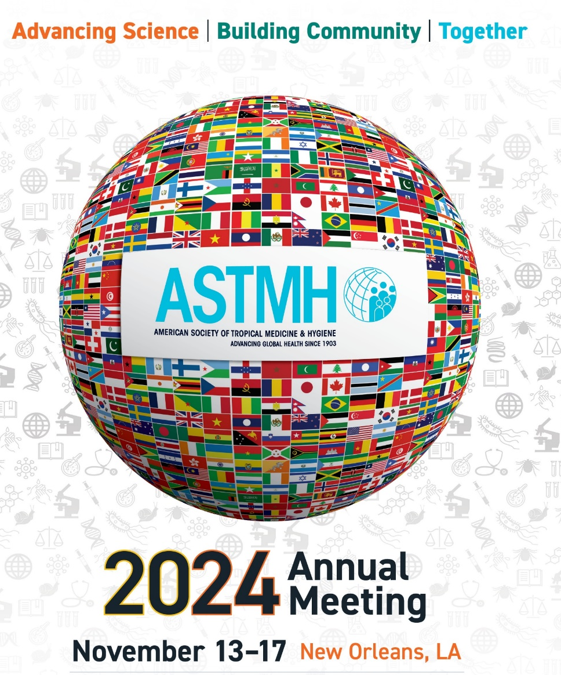
ASTMH Annual Meeting
The premier international forum for the exchange of scientific and clinical advances in tropical medicine, hygiene and global health.
2023 Meeting in Chicago:
4,585 attendees
119 countries represented
1,500 Presentations
  + 1,800 posters

Slide 4

Monthly Scientific Journal
No submission fees
Low publication fees
Open access publishing
Publishing support for LMIC research
Average time to first decision: < 4 weeks
Advance online publication
Track your paper’s visibility
Editorial assistance for supplemental issues

Slide 5
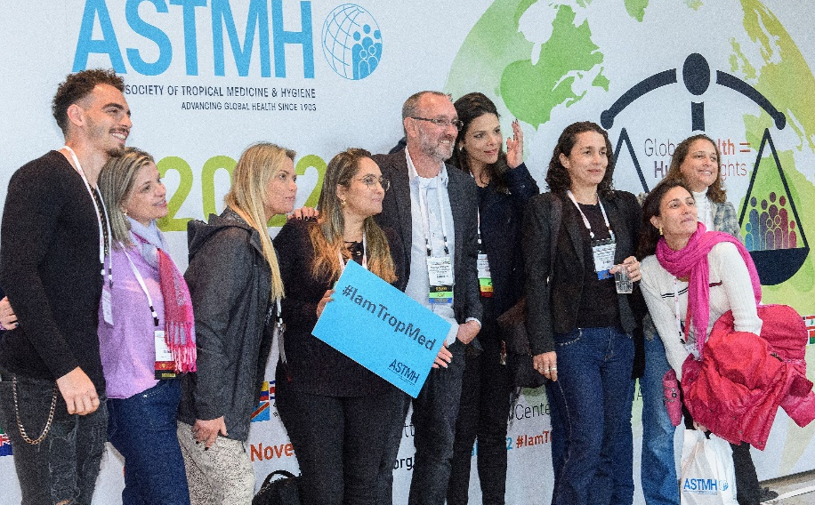

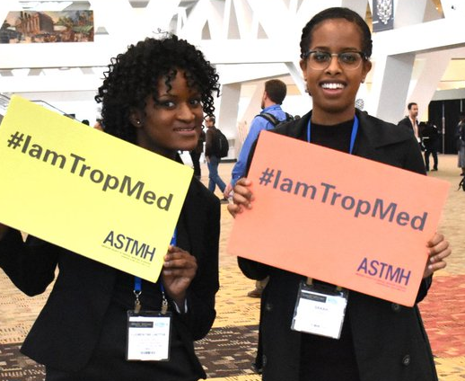
Come Join US!
www.astmh.org

